Slide 1
Paper Reading
Semester Project

Slide 2
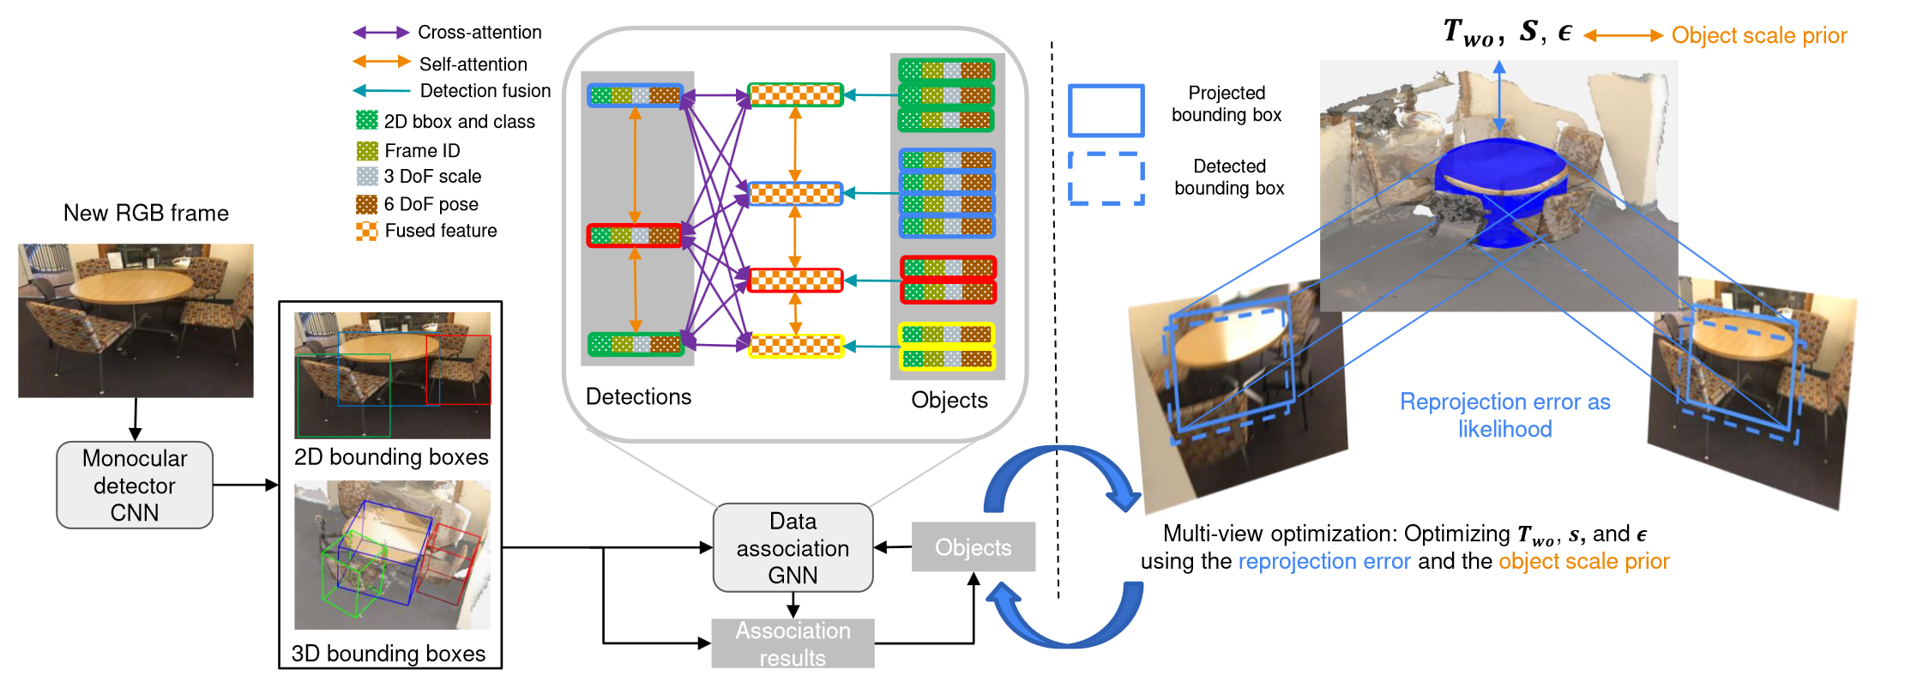
ODAM: Object Detrection, Association, and Mapping using Posed RGB Video
Goal: Localizing objects and estimate their bounding volume (representations) accurately in 3D
Input is only RGB image sequence (Weng et al. uses both 3D point cloud and images)
First step: Estimating 2D attributes (BB and object class) and 3D attributes (translation → depth + 2D center, rotation: three Euler angles)
Second step (Association of Detections): Matching (detections and existing object instances in the map) using an attention-based GNN; Benefits of using GNN: 1. Joint input from different attributes allowed, 2. Info aggragation of attention module (Object fusion + Frame-to-model association)
Third step: Multi-view optimization using super-quadric bounding volume, (a convex set bounded by the intersection region of all frustums)
Notes:
First step: Estimating 2D attributes (BB and object class) and 3D attributes (translation → depth + 2D center, rotation: three Euler angles)
Second step (Association of Detections): Matching (detections and existing object instances in the map) using an attention-based GNN
Benefits of using GNN: 1.

Slide 3
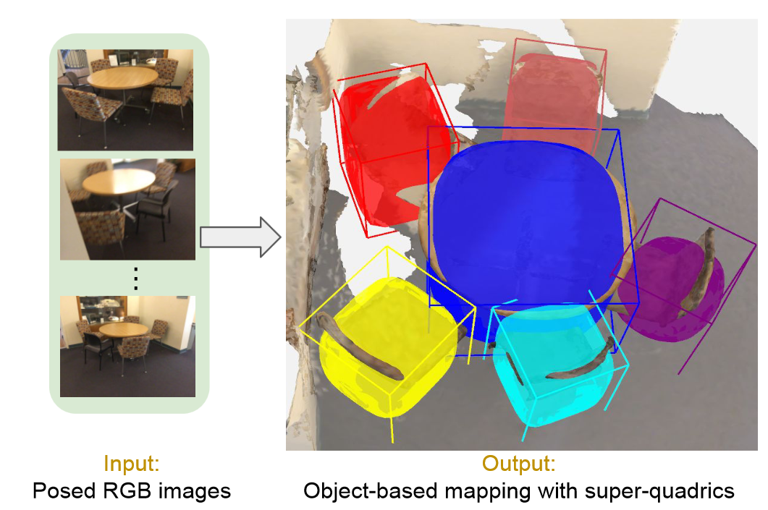
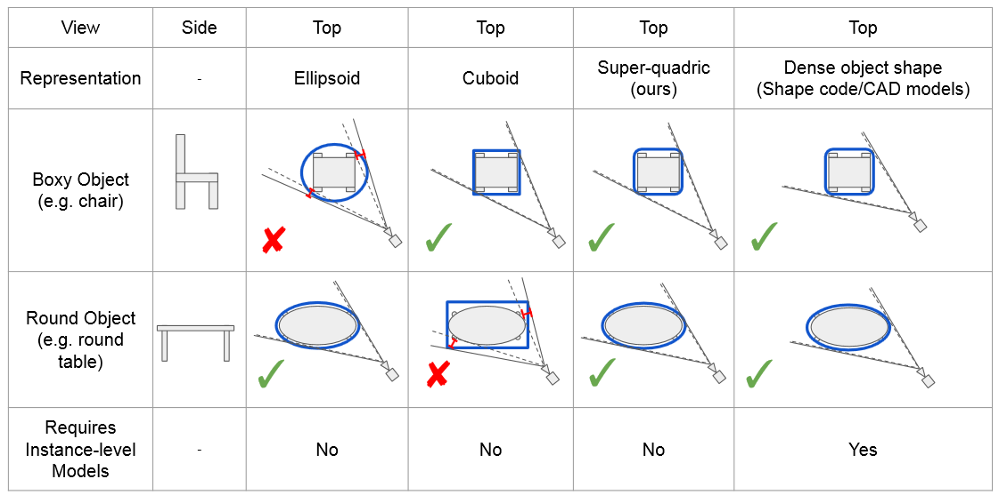
ODAM: Object Detrection, Association, and Mapping using Posed RGB Video
Limitations of object representations in multi-view optimization
Conclusion & Improvement
Comparison with Vid2CAD and MOLTR (metric is mAP of different classes w.r.t case IoU>0.25 and IOU>0.5)
Duplicated objects in V and M (failure in data association) & better orientation of bounding volume
Better performance of super-quadric in contrast to cuboid and ellipsoid
Current method performs well in distantly arranged objects within the same class (bed, table, bath…) but struggles with thin objects (door, window.. ← hard for association)
Implementation
Object detector (DETR)
GNN (3-layer MLP + 4 self-attention layers + Matching Network (similar to SuperGlue))
Optimization details: sample 1000 points on surface

Slide 4
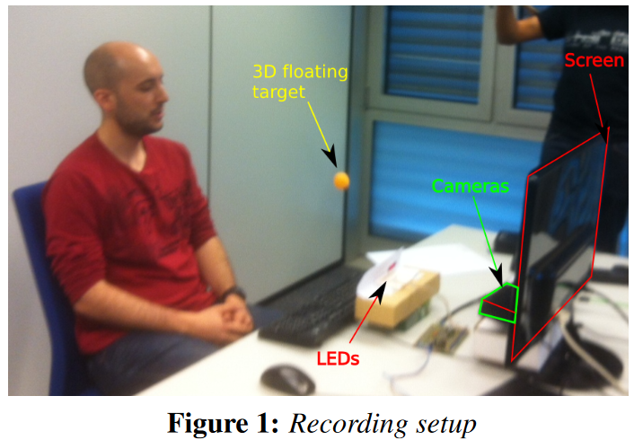
EYEDIAP: a database for the development and evaluation of gaze estimation algorithms from RGB and RGB-D cameras
Head pose variations
Person variation
Ambient and sensing condition
Types of target (screen or 3D object)

Slide 5
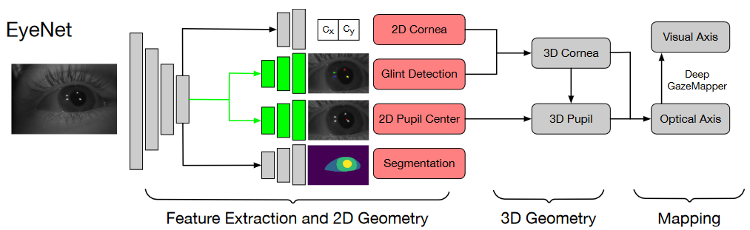
MagicEyes: A Large Scale Eye Gaze Estimation Dataset for Mixed Reality
Green boxes indicate weight sharing

Slide 6
Appearance-based Gaze Estimation With Deep Learning: A Review and Benchmark
Object Detector
Feature Extraction
Object-based mapping
Region of Interest Detection
Active Object
RoI Pooling
(Weighted) Feature Concatenation
How to encode in Network for gaze estimation?
Scene-related information

Slide 7
Extension of Paper Reading
Next-Active-Object prediction from Egocentric Videos (A.Furnari et.al. 2019) https://arxiv.org/abs/1904.05250
GNN3DMOT: Graph Neural Network for 3D Multi-Object Tracking with Multi-Feature Learning (Weng et.al. 2020) https://arxiv.org/abs/2006.07327
Appearance-based Gaze Estimation With Deep Learning: A Review and Benchmark (Cheng et. Al. 2021) https://arxiv.org/abs/2104.12668
Recurrent CNN for 3D Gaze Estimation using Appearance and Shape Cues (C.Palmero et. Al. 2018) https://arxiv.org/abs/1805.03064v3
Gaze Estimation with Eye Region Segmentation and Self-Supervised Multistream Learning (2021)
Semantic 3D gaze mapping for estimating focused objects (R.Matsumoto 2019)

